Slide 1
A comparative analysis of discrete choice models estimations, using different software packages
Semester project, Midterm Presentation
Alexia Paratte
Supervised by Evangelos Paschalidis, Negar Rezvany and Michel Bierlaire

Slide 2
Outline
Project Description
First Model
Second Model
Future goals

Slide 3
Project Description
Motivation and Process

Slide 4
Motivation
Discrete choice models widely used: transportation, environment, economics, marketing
Many software to estimate these models, such as Biogeme (Python) and Apollo (RStudio)
Goal: Comparing Biogeme and Apollo -> performances, results, available features
Different kind of models
Notes:
Avoid long text, be precise (more bulletpoint, less words)

Slide 5
Process
Example scripts from the Apollo website and translate them to Biogeme
Make sure the models are equivalent: toml file, panel data, FLL, etc
Compare the estimation times for both software
Compare CPU/RAM usage

Slide 6
First Model
MNL Revealed Preferences Model

Slide 7
Model and data description
Most basic MNL (Multinomial Logit Model) on Apollo website, revealed preferences, called RP_Model
Synthetic dataset apollo_modeChoiceData looking at mode choice for 500 travelers.
Choices are either car, bus, air or rail
Parameters (9 to be estimated): travel time, travel cost, access (except for car)
Availabilities

Slide 8
Estimation Results
PARAMETERS | VALUE IN APOLLO | VALUE IN BIOGEME
ASC_BUS | 0.475 | 0.471
ASC_AIR | 1.629 | 1.630
ASC_RAIL | 0.945 | 0.941
BETA_TT_CAR | - 0.004 | - 0.004
BETA_TT_BUS | - 0.009 | - 0.009
BETA_TT_AIR | - 0.021 | - 0.021
BETA_TT_RAIL | - 0.011 | - 0.011
B_ACCESS | - 0.011 | - 0.012
B_COST | - 0.034 | - 0.034
Notes:
Not sure whether this is relevant, maybe just say got same results in both Apollo/Biogeme go through the slide quickly)

Slide 9
Statistics
 | VALUE IN APOLLO | VALUE IN BIOGEME
Initial Loglikelihood | -1170.86 | -1170.86
Final Loglikelihood | -1025.76 | -1025.756
Estimation Time | 00 : 00 : 1,51 | 00 : 00 : 1,54
Notes:
Have a table (statistics results) (FL, time estimage, image of CPU and RAM) (maybe try to simplify code)

Slide 10
Second Model
MMNL Preferences Model

Slide 11
Model and data description
MMNL Model (Multinomial Mixture logit model), called MMNL_Preference_Model
apollo_swissChoiceRouteData, comes from a SP survey of public transport route choice conducted in Switzerland (Axhausen et al., 2008).
388 people, two public transport routes
Panel data
No availabilities
Parameters: travel time, travel cost, headway, number of interchanges
500 Halton Draws with Monte-Carlo Estimation. Estimation of means and standard deviations of the random coefficients

Slide 12
All MMNL_Models
First Model: MMNL_Preference_Model_Biogeme_0
No use of Panel Data (error in translation from Apollo to Biogeme)
Starting estimation values in Biogeme same a starting values in Apollo
Second Model: MMNL_Preference_Model_Biogeme_1
No use of Panel Data again
Starting estimation values in Biogeme same as estimated parameters in Apollo (local solution)
Final Model: MMNL_Preference_Model_Biogeme_final
Considering Panel Data

Slide 13
Estimation Results Final MMNL
PARAMETERS | VALUE IN APOLLO | VALUE IN BIOGEME
MU_LOG_B_TT | - 1.984 | - 2.540
SIGMA_LOG_B_TT | - 0.441 | - 0.577
MU_LOG_B_TC | - 1.016 | - 2.620
SIGMA_LOG_B_TC | - 0.991 | - 1.890
MU_LOG_B_HW | - 2.938 | - 3.070
SIGMA_LOG_B_HW | - 0.834 | 0.268
MU_LOG_B_CH | 0.631 | 0.251
SIGMA_LOG_B_CH | 0.858 | 0.801
Notes:
Not sure whether this is relevant, maybe just say got same results in both Apollo/Biogeme go through the slide quickly)

Slide 14
Statistics Final MMNL
 | VALUE IN APOLLO | VALUE IN BIOGEME
Initial Loglikelihood | - 2’253.78 | -1703.93
Final Loglikelihood | - 1’444.35 | -1534.219
Estimation Time | 00 : 03 : 25 | 00 : 46 : 19
Notes:
Have a table (statistics results) (FL, time estimage, image of CPU and RAM) (maybe try to simplify code)

Slide 15
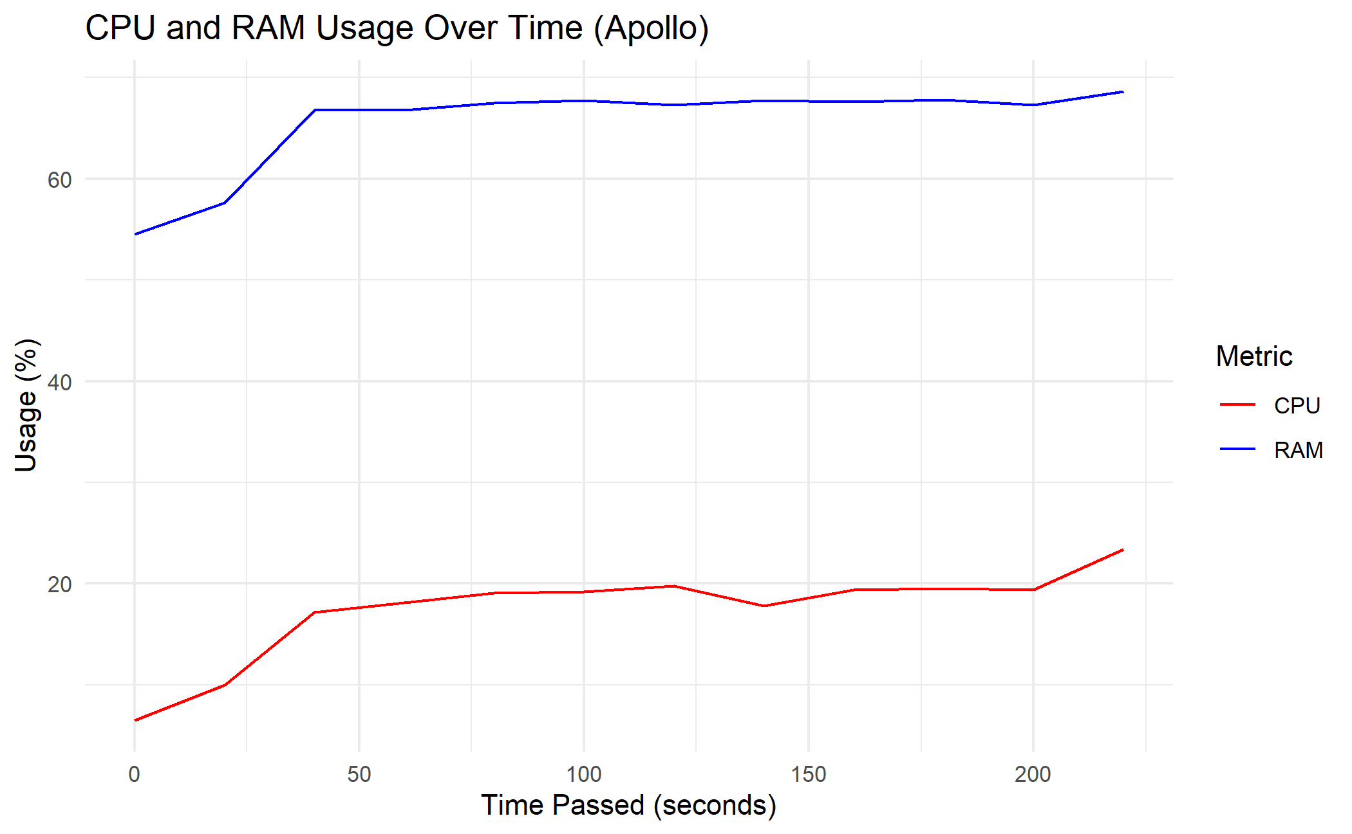
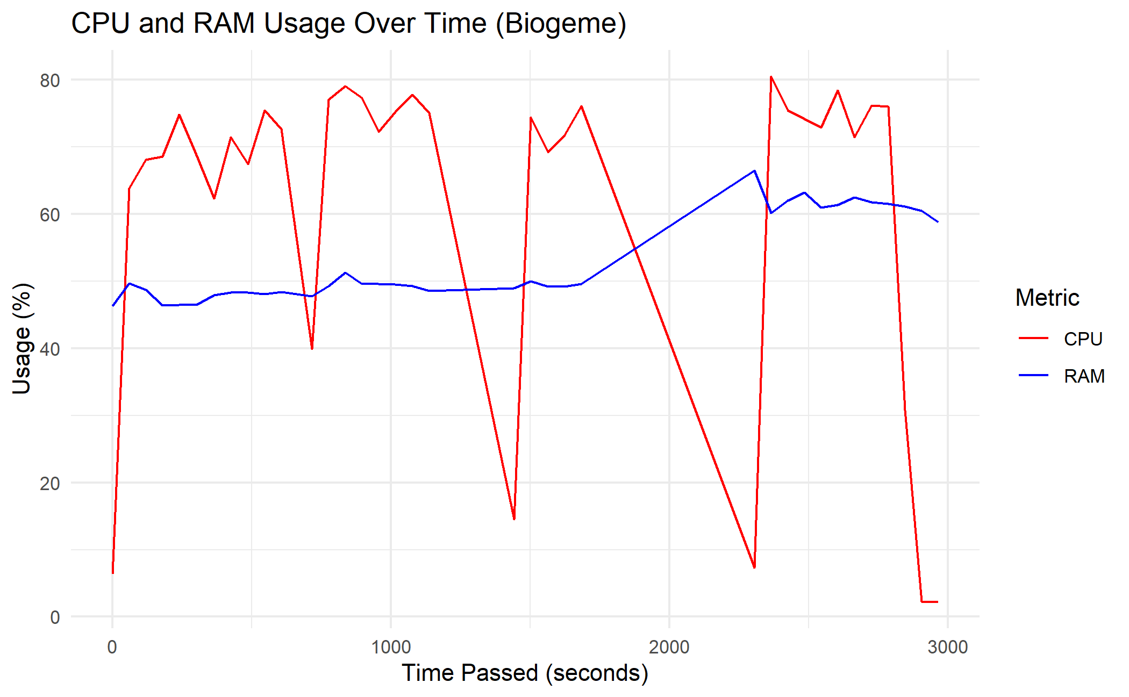
CPU & RAM usage

Slide 16
Future Goals
Challenges and planning

Slide 17
Challenges faced
Getting accustomed to Apollo
Errors in translation from Biogeme to Apollo
Missing information (eg: BioDraws function in Biogeme)
Trying implementing CPU/RAM usage measurement function

Slide 18
Planning for the following weeks
To avoid errors in translation from Apollo to Biogeme, want to choose model/dataset from the Biogeme website and translate it to Apollo
Another solution would be to simplify the model in Apollo
Optimisation-wise: want to modify the following parameters in the .toml file in Biogeme:
second derivatives: proportion (between 0 and 1) of iterations when the analytical Hessian is calculated
optimization algorithm: optimization algorithm to be used for estimation.
Try other choice models

Slide 19
Thank you for listening !

Slide 20
References
Hess, S. & Palma, D. (2019), Apollo: a flexible, powerful and customisable freeware package for choice model estimation and application, Journal of Choice Modelling
Michel Bierlaire (2023), A Short introduction to Biogeme
Michel Bierlaire (2023), École Polytechnique Fédérale de Lausanne, Biogeme Sphinx Documentation [https://biogeme.epfl.ch/sphinx/]

